Slide 1
ADOPTION Overview
Advanced Co-Packaged Optics Enabling High Efficiency Artificial Intelligence Workload and Cloud Computing
09/02/2023

Slide 2
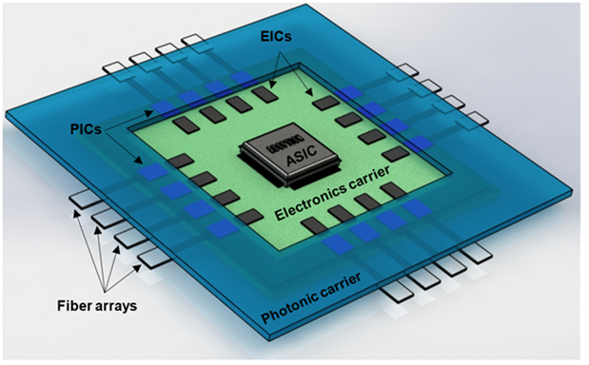
The ADOPTION Project
Develop an advanced co-packaged optics eco-system that enable the evolution of novel network architectures for cloud application
Targeting application for 204.8Tb/s switches – beyond 2026
Optical ports 6.4Tb/s
100Gb/s NRZ – 3pJ/bit
16λ x 4 fibres
Classic hyper-scale cloud application
Edge cloud A.I.
Large Radix and flat architecture
Dynamic allocation of flows – big data stream

Slide 3
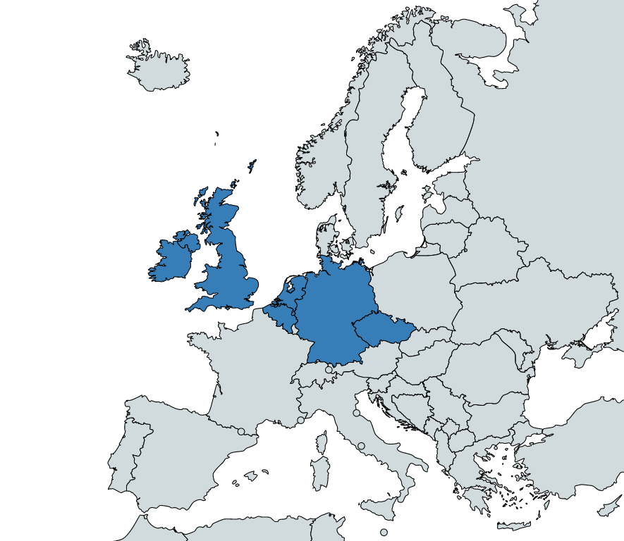
Consortium
01/01/2023 – 31/12/2025
Project Budget : 6.4M €
EU Contribution: 5.5M €
 |  | Short Name
1 | Tyndall (Coordinator) | TNI | Academia | Ireland
2 | Argotech | AT | Industry | Czech Republic
3 | Huawei | HWDU | Industry | Germany
4 | MicroAlign | MA | SME | Netherlands
5 | Pilot Photonics | PIL | SME | Ireland
6 | TU/e | TU/e | Academia | Netherlands
7 | IMEC/Ghent | IMEC | Academia | Belgium
8 | Resolute Photonics | RSL | SME | Ireland
9 | Fraunhofer IZM | Fraunhofer | Academia | Germany
10 | SENKO Advanced Components (Euro) Ltd. | SNK | Industry | Industry
Notes:
Project Budget on average: ~6000 euros/day for 3 years.

Slide 4
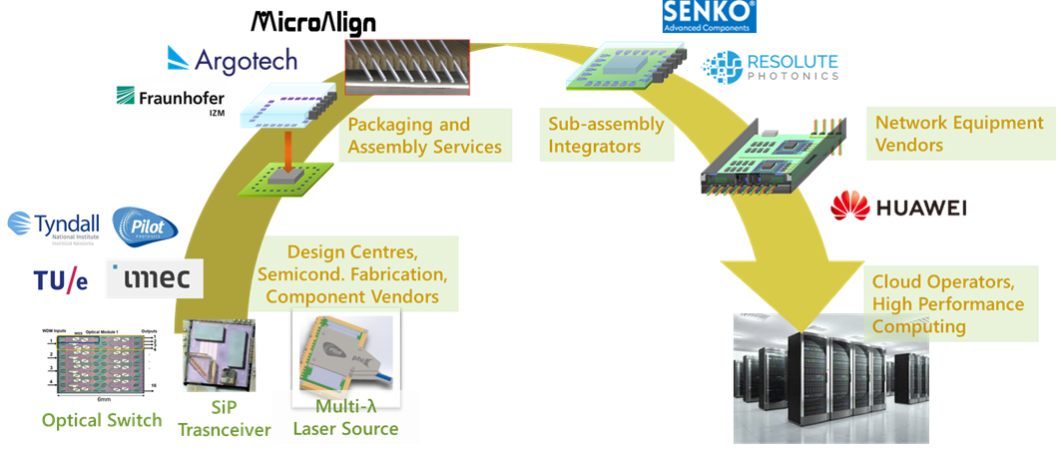
Project Ambition: Co-Packaged Optics Ecosystem
a complete value chain from chip fabrication, to advanced assembly, system integration and to the deployment by cloud computing operators.
standardisation – training – synergies with other EU consortia/Pilot lines etc…

Slide 5
Objective 1: Novel Optical Switching Architectures
targeting artificial intelligence (AI) training and flatter electrical switching networks in data centres.
High capacity co-packaged electronic switch
204.8Tb/s - 32 ports
6.4Tb/s per port: (100Gb/s NRZ x 16λ) x 4 fibres
Low power 3pJ/bit, Low cost 50cent/Gb/s
Distributed photonic WDM switches
Reduced traffic congestion, (<50ns) switching
Low latency (<200ns)
Connects 4096 computing nodes

Slide 6
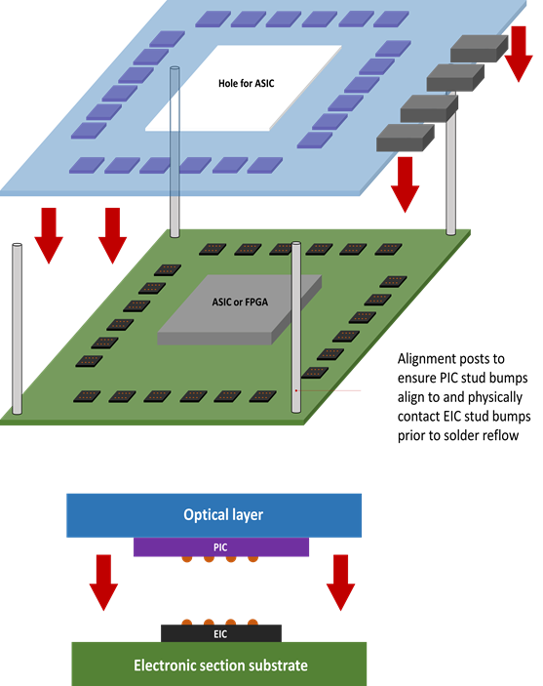
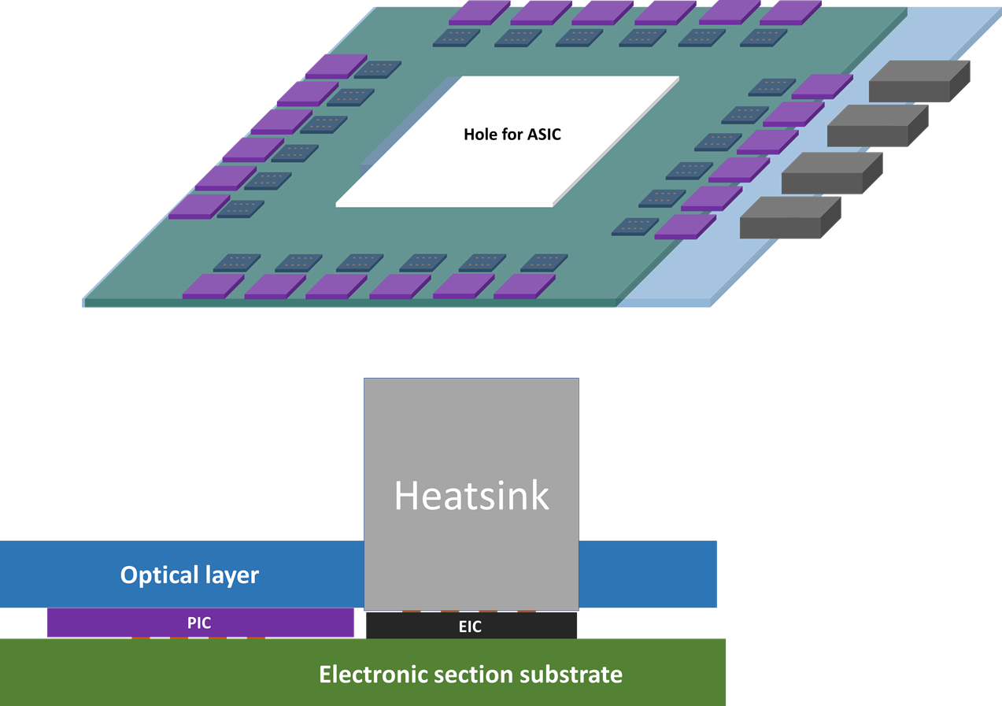
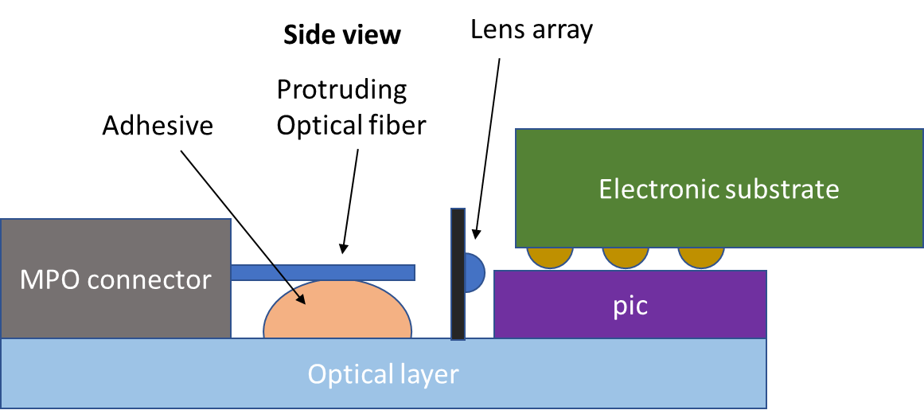
Objective 2: Low-cost co-packaging and fibre coupling
minimises the distance over which high speed electronic signals propagate prior to electro-optic conversion
Relaxes assembly tolerances
2 Part CPO Assembly Concept
Alternative 2.5D arrangement
PICs are adjacent, not on top of EICs
Optical interface:
Fiber alignment
Fiber fixation with lens
2.5D and 3D co-packaging of high-speed electronics and photonic integrated circuits (PICs) using a novel two-parts packaging.
High efficiency fibre coupling with active alignment method

Slide 7
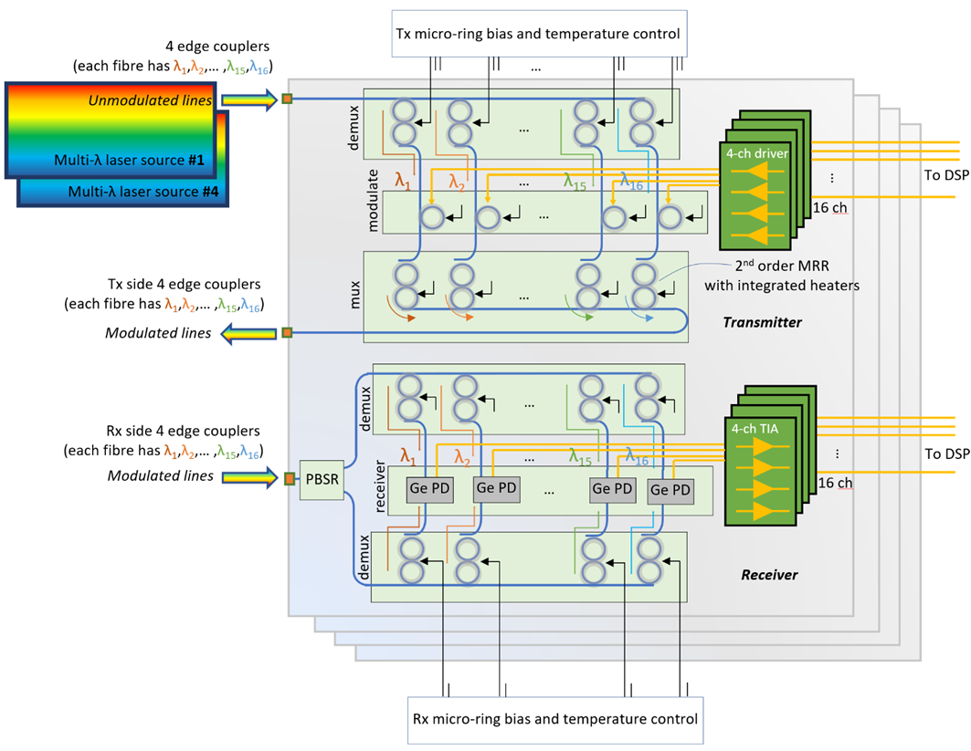
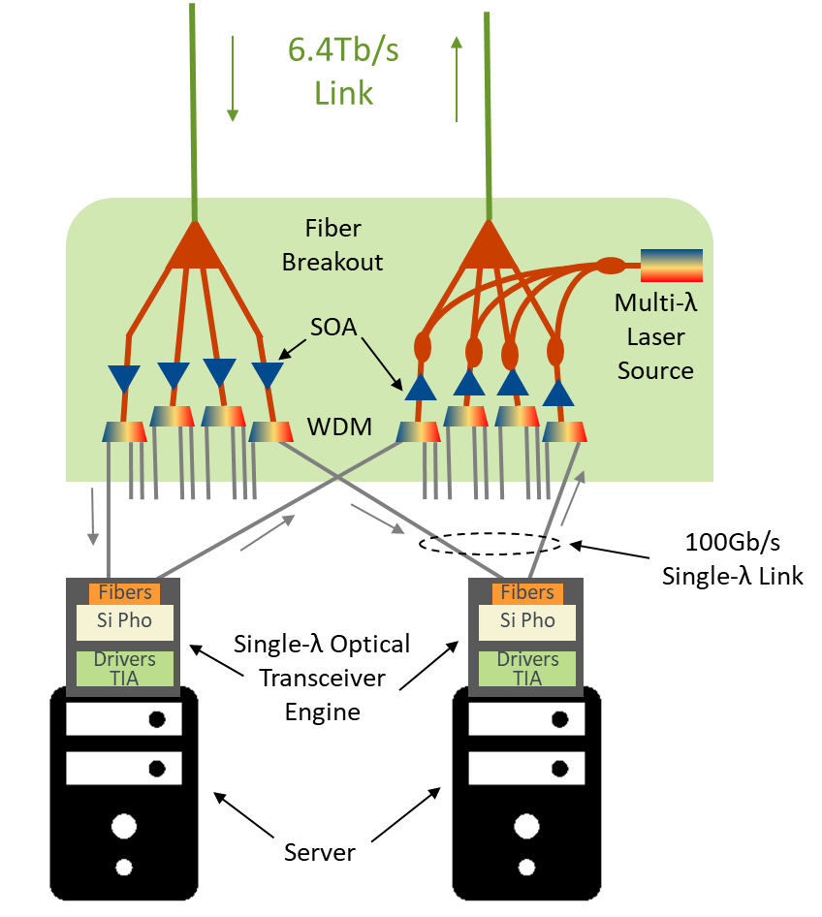
Objective 3: High-Capacity Optical Transceivers and DWDM Photonics
Parallel Silicon Photonic based optical transceiver engines (100Gb/s NRZ x 16λ) x 4 fibres
Low-power multi-wavelength laser source
Nanoseconds photonic WDM switches
Port breakout, static space and wavelength multiplexing

Slide 8
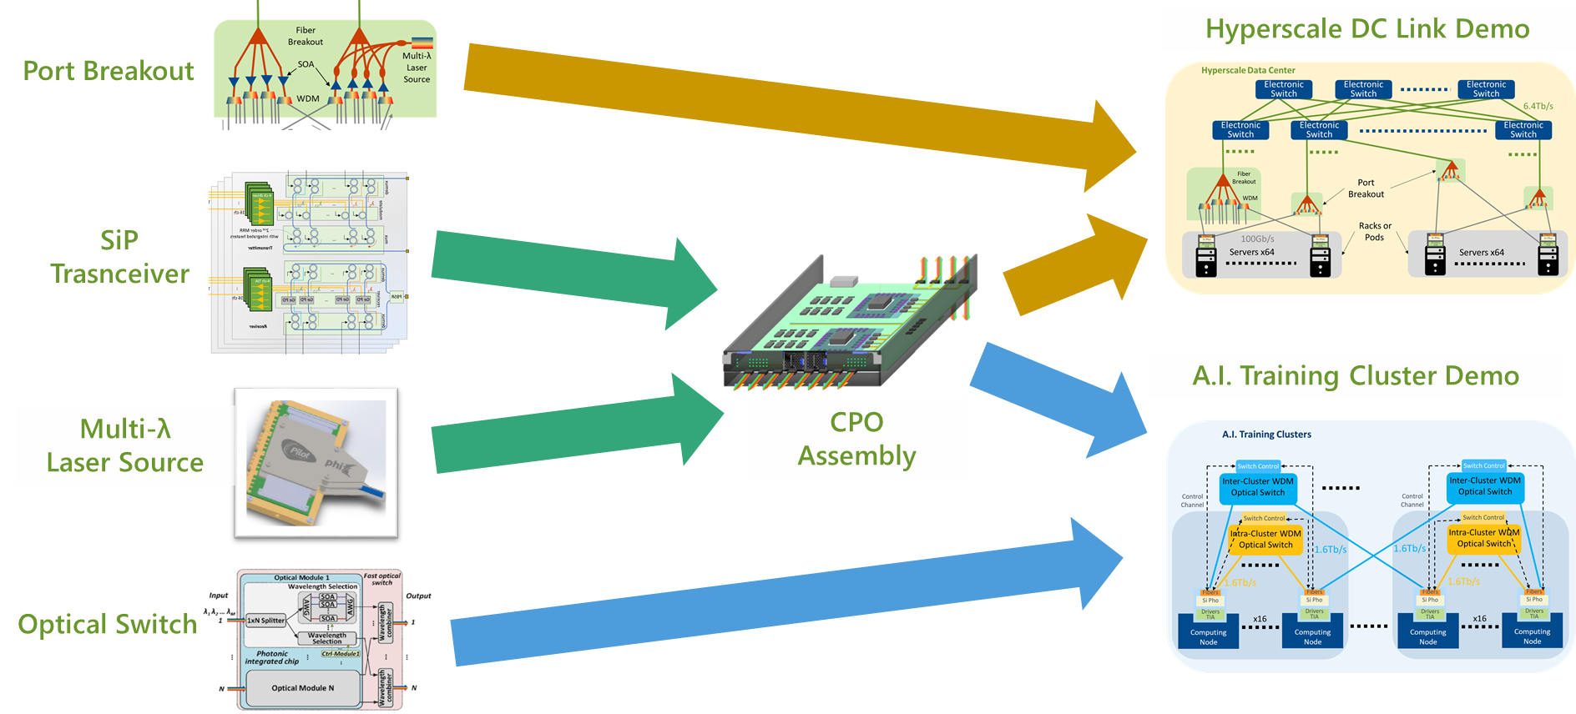
From Components to Demonstration

Slide 9
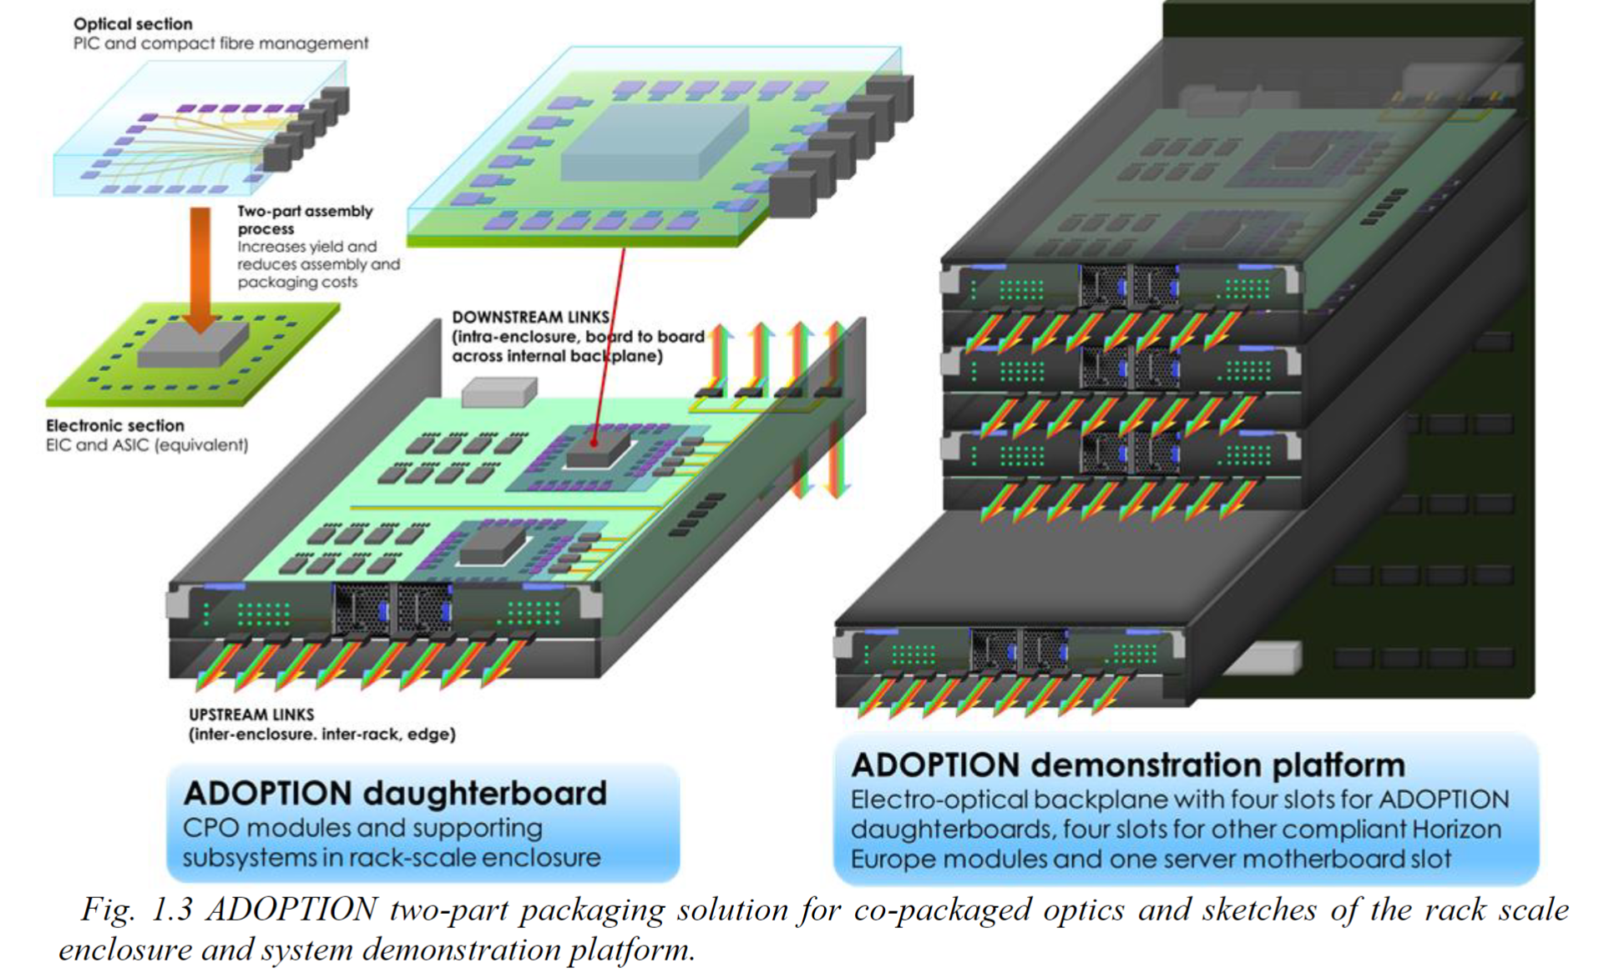
Demonstration Platform

Slide 10
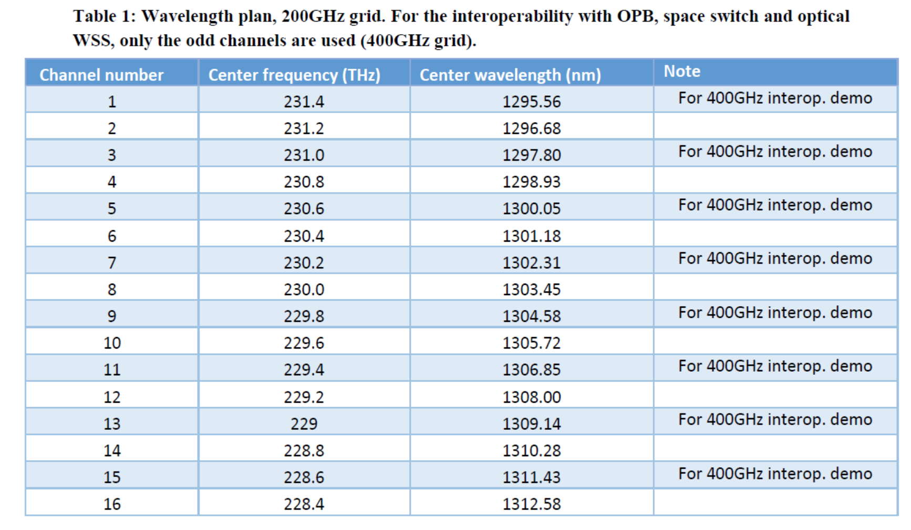

Slide 11
This project has received funding from the European Union’s Horizon Europe innovations actions programme under grant agreement No 101070178

